Slide 1
Clinical Imaging Informatics IAP 2017 Lab 3
Jayashree Kalpathy-Cramer
Henning Mueller
Andrew Beers
Ken Chang
Artem Mamonov

Slide 2
Labs
Radiomics
Feature extraction
Classification (machine learning)

Slide 3
Introduction to NVIDIA Deep Learning GPU Training System (DIGITS) Ken Chang et al

Slide 5
Resources
Based on tutorial
https://www.learnopencv.com/deep-learning-example-using-nvidia-digits-3-on-ec2/
Data from
http://www.robots.ox.ac.uk/~vgg/data/flowers/17/
NVIDIA DIGITS
https://github.com/NVIDIA/DIGITS

Slide 6
What is DIGITS?
An interactive user interface that simplifies the task of data management, deep learning, and performance visualization
No programming required!

Slide 7

Getting Started
Open a browser and type in IP address 155.52.190.4

Slide 8
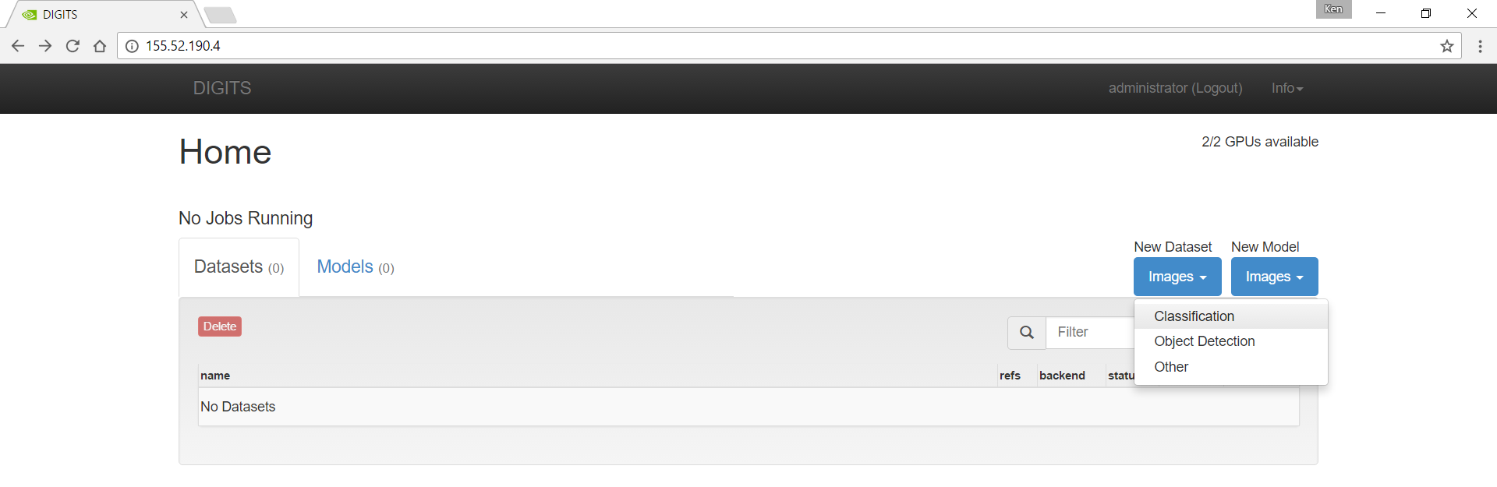
New Dataset > Images > Classification

Slide 9
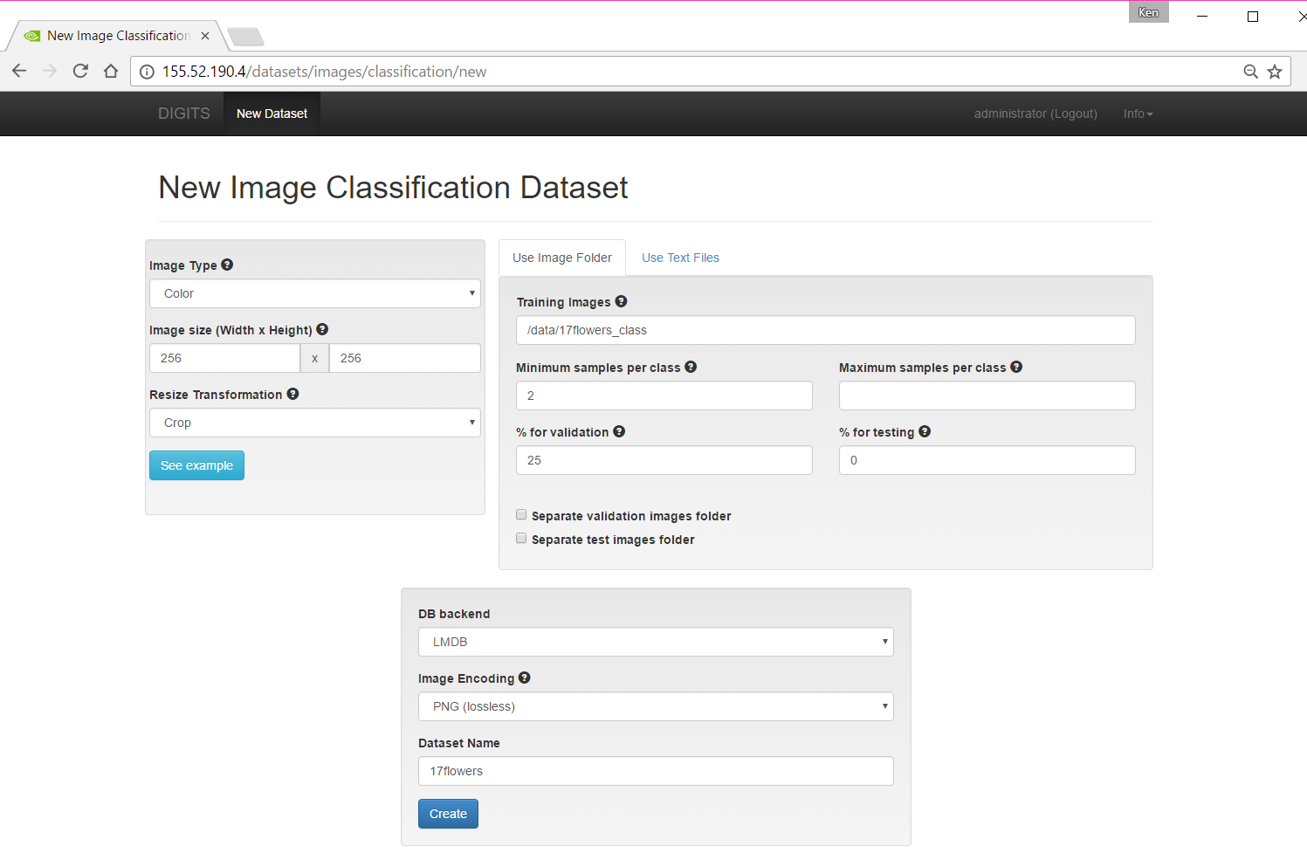

Slide 10
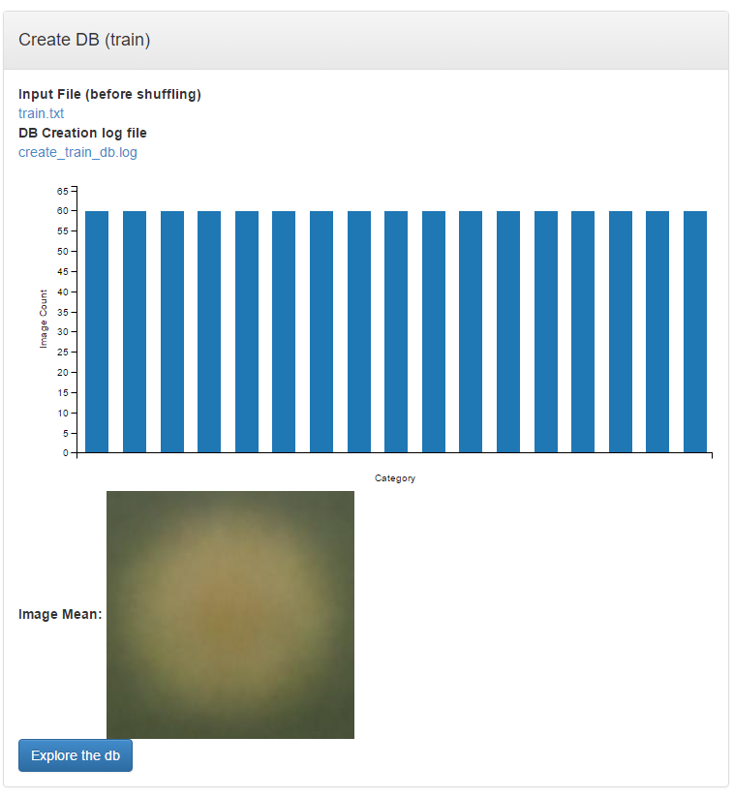
Let’s take a look at the dataset …

Slide 11
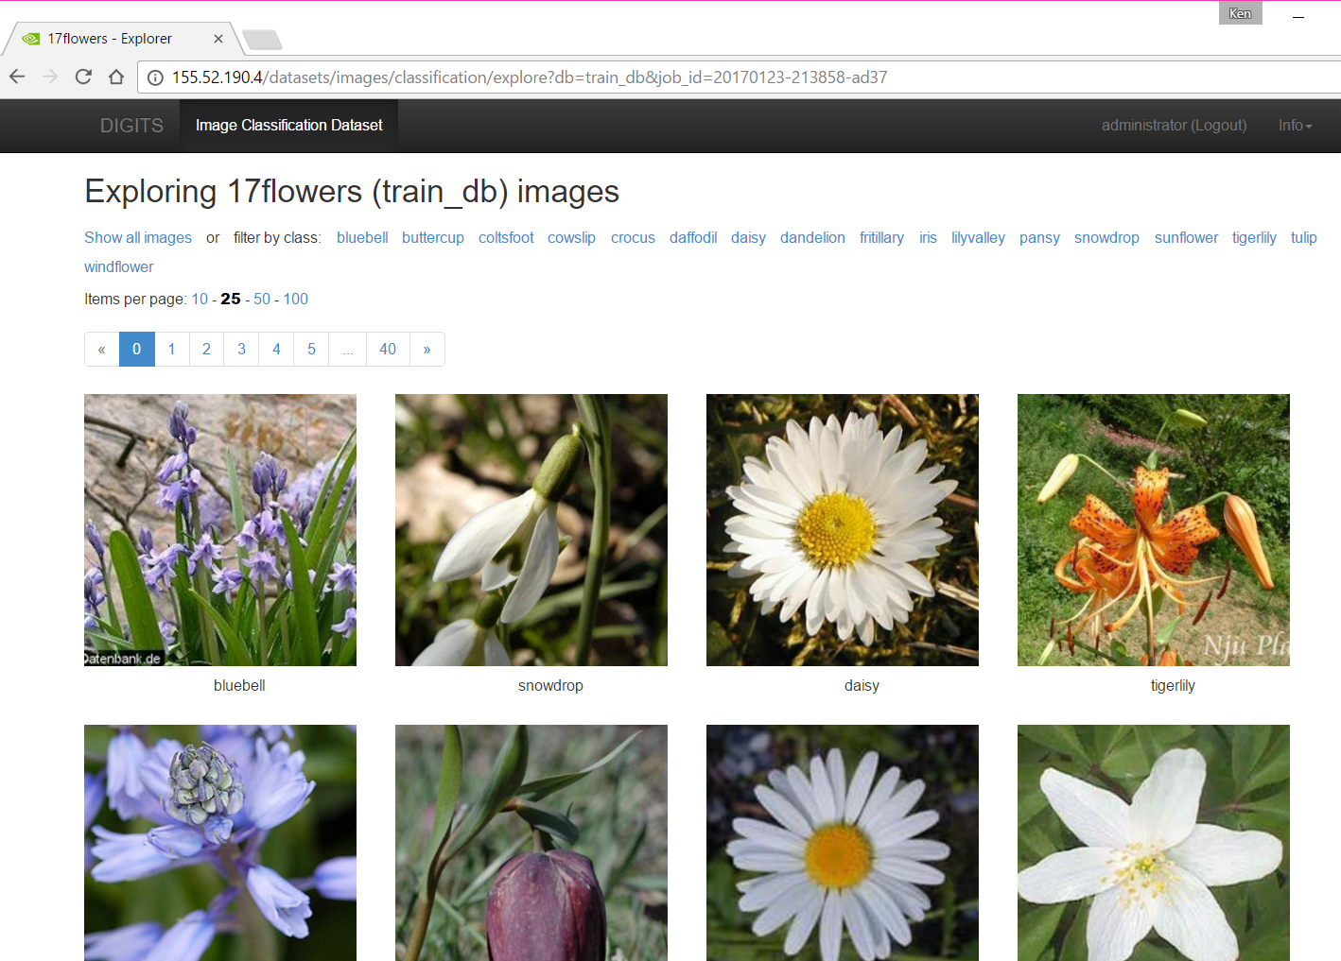
Click through the 17 categories of flowers!

Slide 12
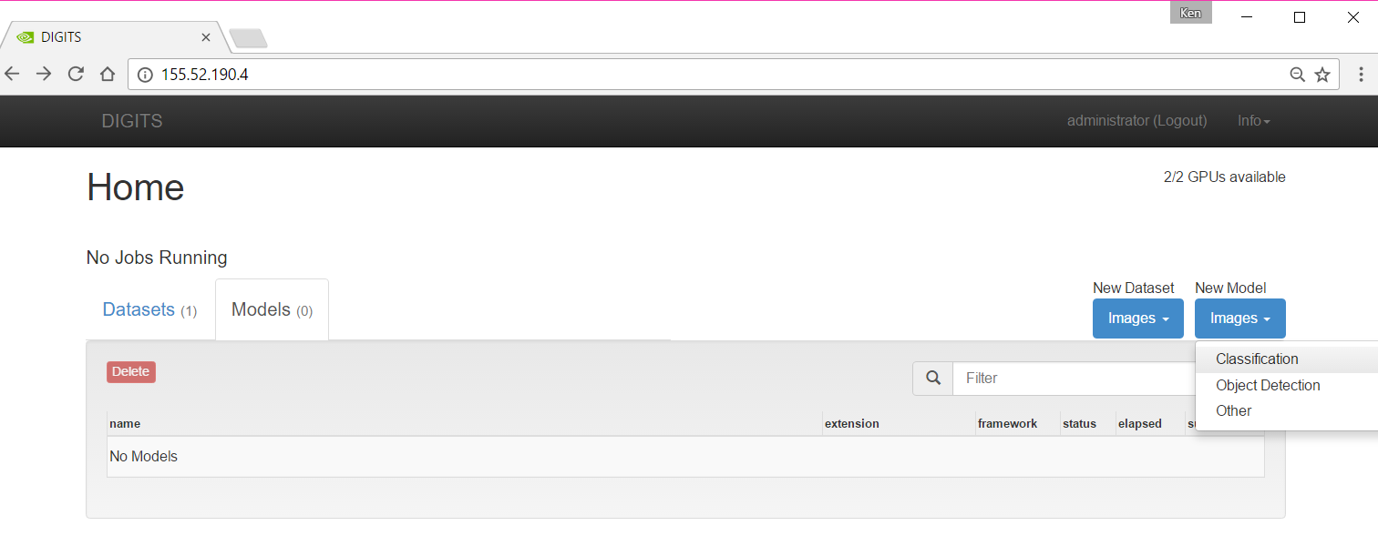
Let’s make our deep learning model
Click “DIGITS” in the top left corner to return to the home page

Slide 13
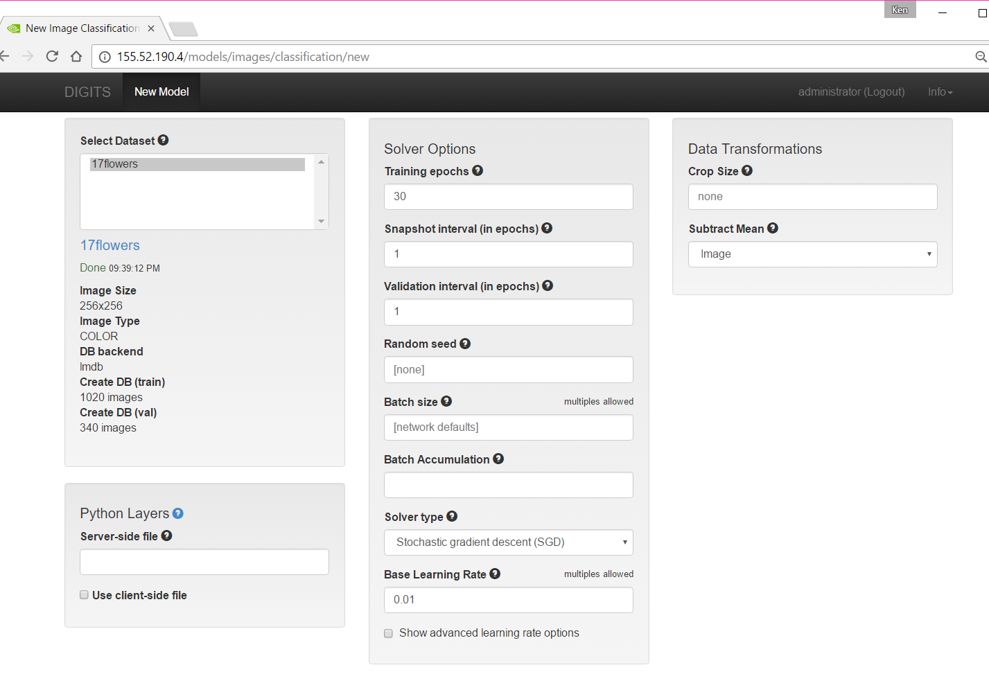

Slide 14
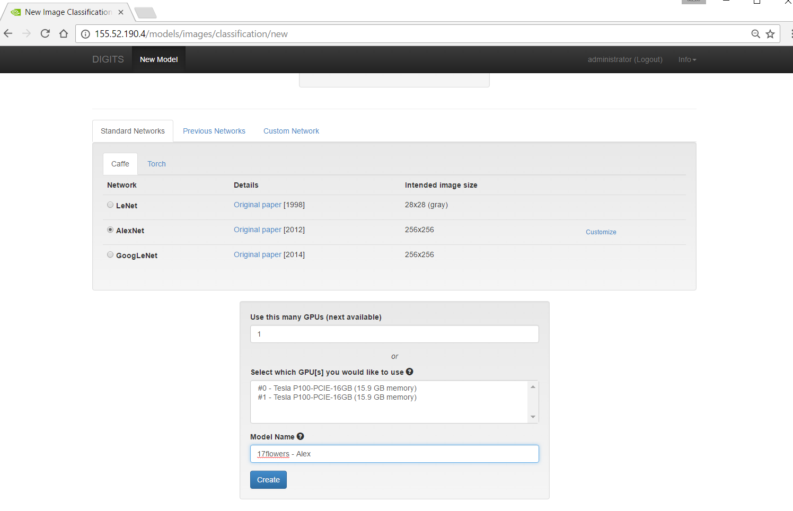

Slide 15
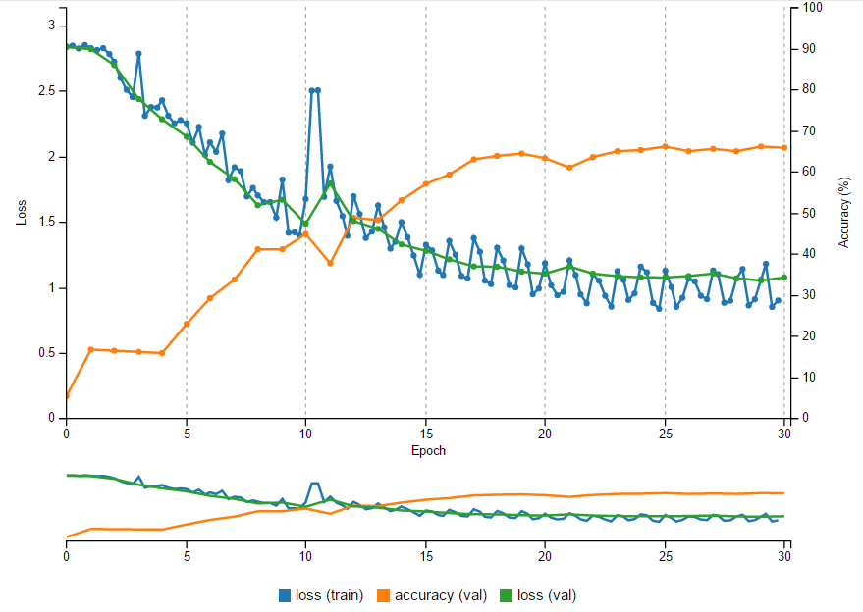
After a few minutes …
Validation Accuracy ~66% using default settings

Slide 16
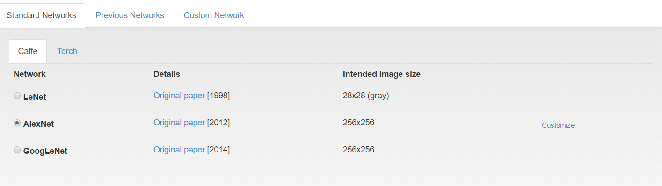
Can we do better?
Let’s try using pre-trained weights from the original AlexNet paper

Slide 17
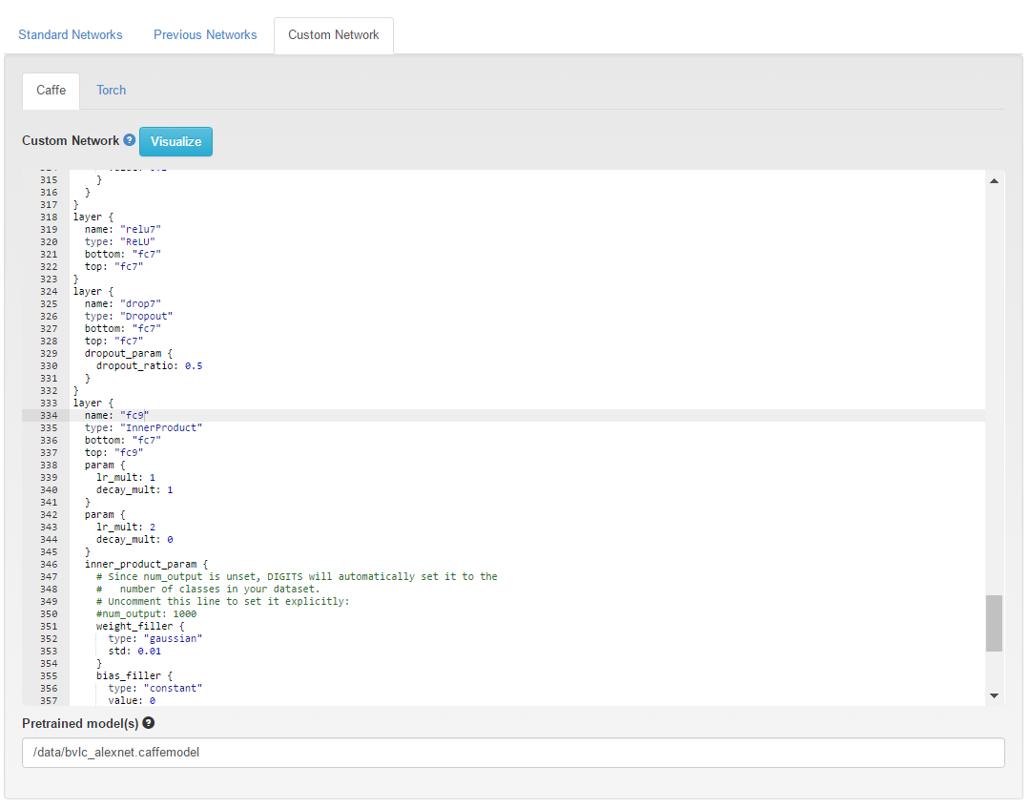
Make some small changes…
Replace all instances of “fc8” with “fc9”

Slide 18
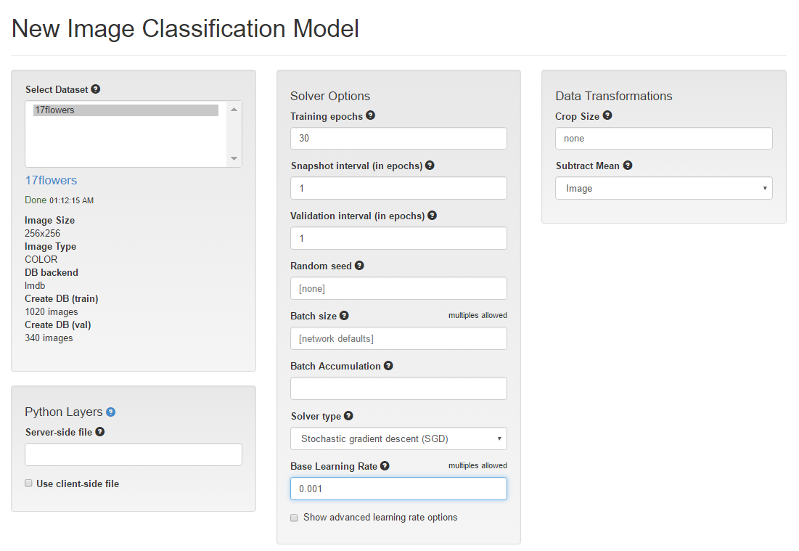
Reduce the learning rate

Slide 19
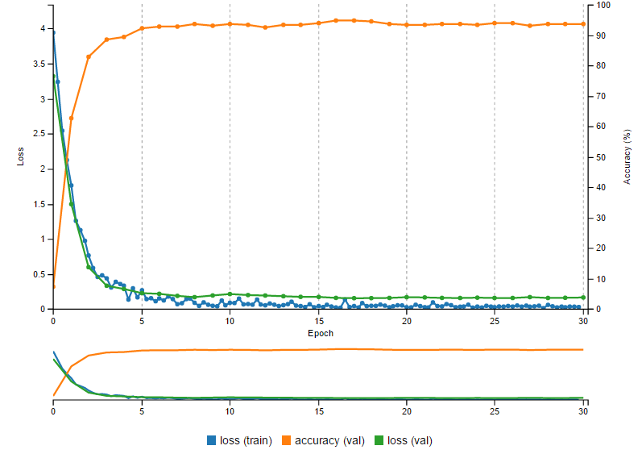
94% Validation Accuracy!

Slide 20
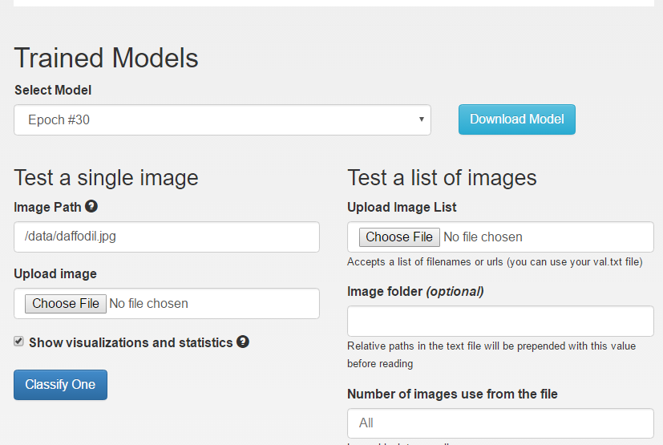
Let’s see if the classifier works on a new image …

Slide 21
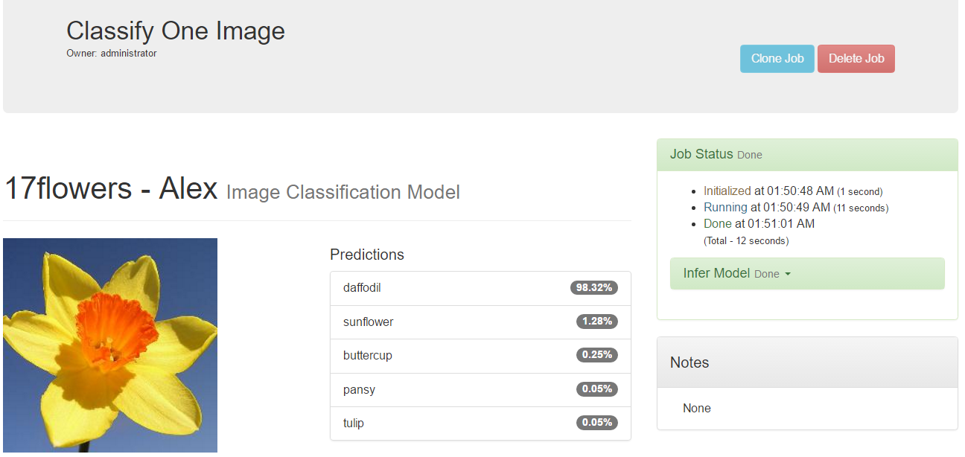
Success!

